Slide 1

Hotel Reservation Analysis
- using SQL
Presented By:-
Shivam Shivhare

Slide 2

Project Overview
The hotel industry relies on data to make informed decisions and provide a better guest experience. In this project, I worked with a hotel reservation dataset to gain insights into guest preferences, booking trends, and other key factors that impact the hotel's operations. Used SQL to query and analyze the data, as well as answer specific questions about the dataset.

Slide 3
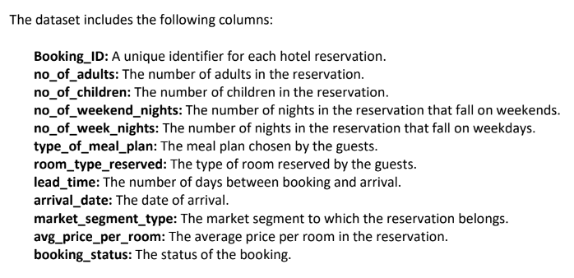
Dataset Details

Slide 4
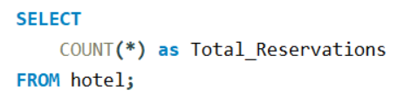
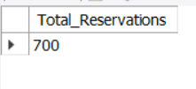
Data Analysis Tasks
1. What is the total number of reservations in the dataset?
Overview:
The dataset includes 700 reservations.

Slide 5
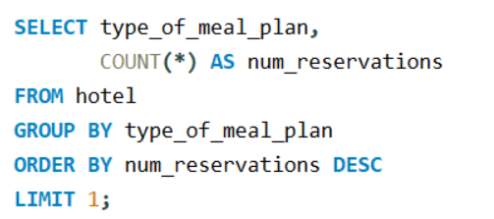

Data Analysis Tasks
2. Which meal plan is the most popular among guests?
Overview:
The most popular meal plan among guests is Meal Plan 1.

Slide 6
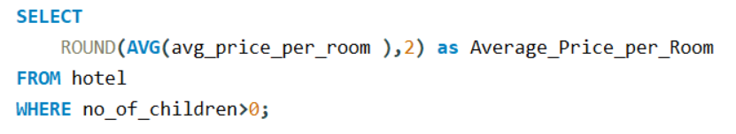

Data Analysis Tasks
3. What is the average price per room for reservations involving children?
Overview:
Children’s reservations have an average room price of 144.57.

Slide 7
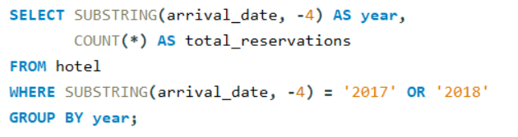

Data Analysis Tasks
4. How many reservations were made for the year 20XX (replace XX with the desired year)?
Overview:
A total of 123 bookings were made in 2017. As in 2018, the number of bookings increased significantly, and it is showing healthy growth.

Slide 8
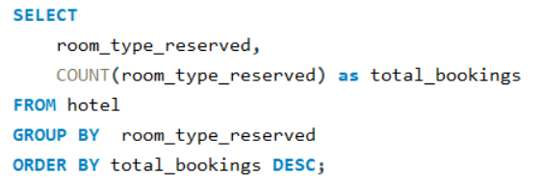
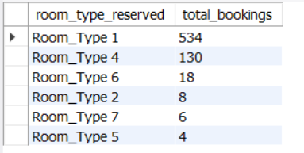
Data Analysis Tasks
5. What is the most commonly booked room type?
Overview:
The most booked room by the guests is of Room_Type 1 with total bookings of 534.

Slide 9
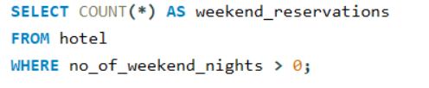

Data Analysis Tasks
6. How many reservations fall on a weekend (no_of_weekend_nights > 0)?
Overview:
Number of reservations on a weekend is 383, it shows that on weekend the numbers of bookings is less as compared to weekdays.

Slide 10
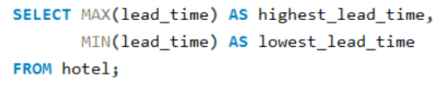

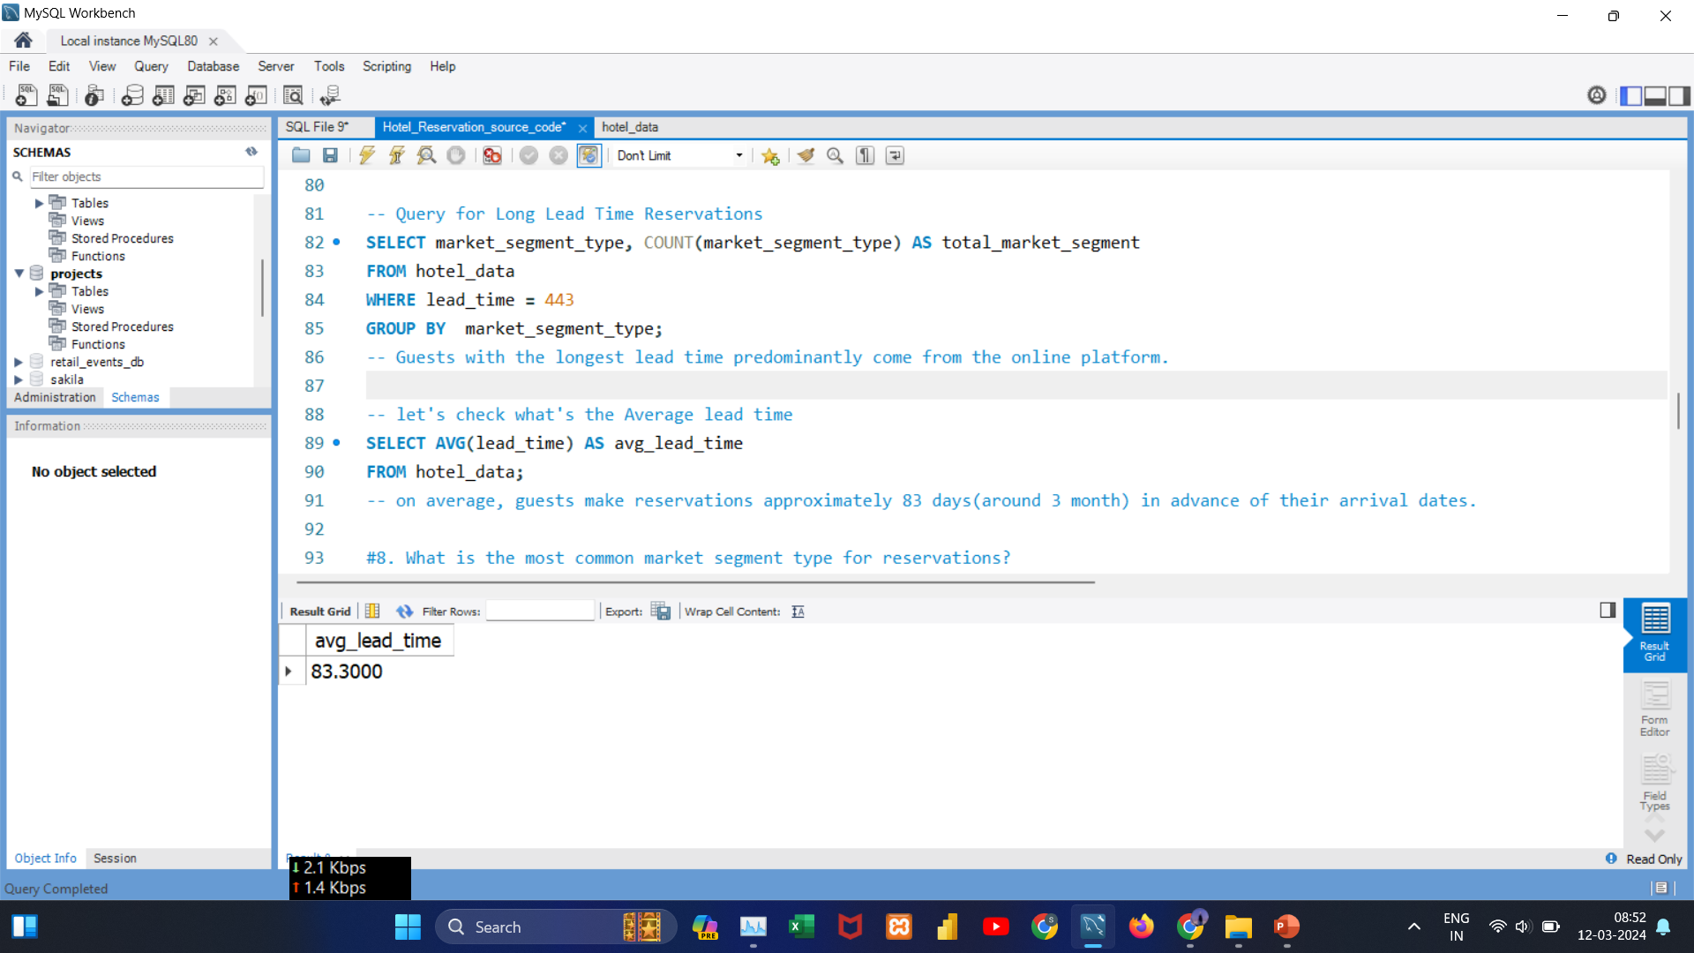
Data Analysis Tasks
7. What is the highest and lowest lead time for reservations?
Overview:
The lead time range of 0 to 443 days reflects a wide diversity of visitor booking behaviours. Some people prefer to make last-minute bookings, while others prepare ahead of time. Reservations are typically made 83.30 days in advance.

Slide 11
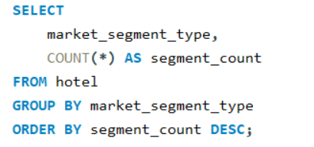
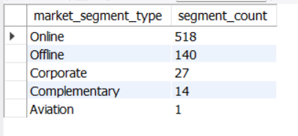
Data Analysis Tasks
8. What is the most common market segment type for reservations?
Overview:
The online market segment is the most popular choice among guests , showcasing a clear preference for online reservations.

Slide 12
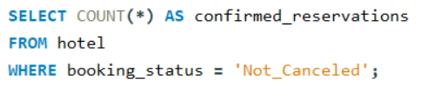

Data Analysis Tasks
9. How many reservations have a booking status of "Confirmed"?
Overview:
It have 493 reservations that has a booking status of “Confirmed”.

Slide 13
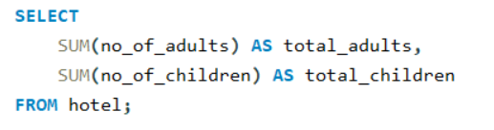

Data Analysis Tasks
10. What is the total number of adults and children across all reservations?
Overview:
The bulk of reservations (1,316) are for adult visitors, with only 69 for children. This demonstrates the hotel's core attraction to adults.

Slide 14
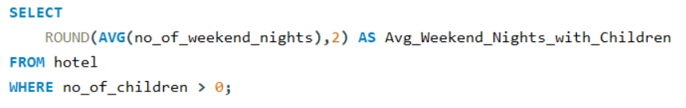

Data Analysis Tasks
11. What is the average number of weekend nights for reservations involving children?
Overview:
The average number of weekend nights for reservation involving children is 1, showing a preference for weekend stays, especially for families.

Slide 15
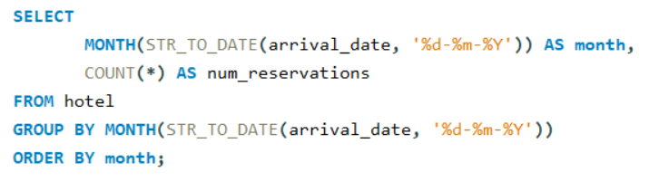
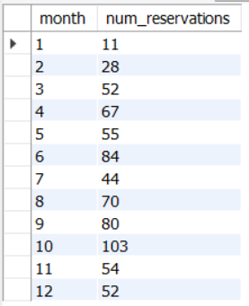
Data Analysis Tasks
12. How many reservations were made in each month of the year?
Overview:
October stands out as the peak reservation month followed by June and September . In contrast, January records the lowest number of reservations, indicating a quieter period.

Slide 16
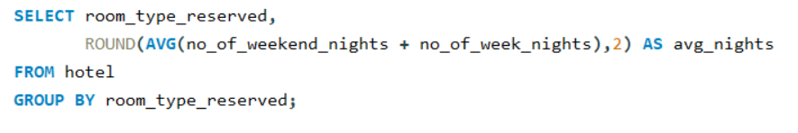
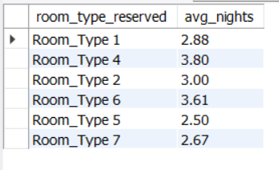
Data Analysis Tasks
13. What is the average number of nights (both weekend and weekday) spent by guests for each room type?
Overview:
Guests in Room Type 4 spend the most nights (3.80 on average), while those in Room Type 5 have the shortest average stay (2.50).

Slide 17
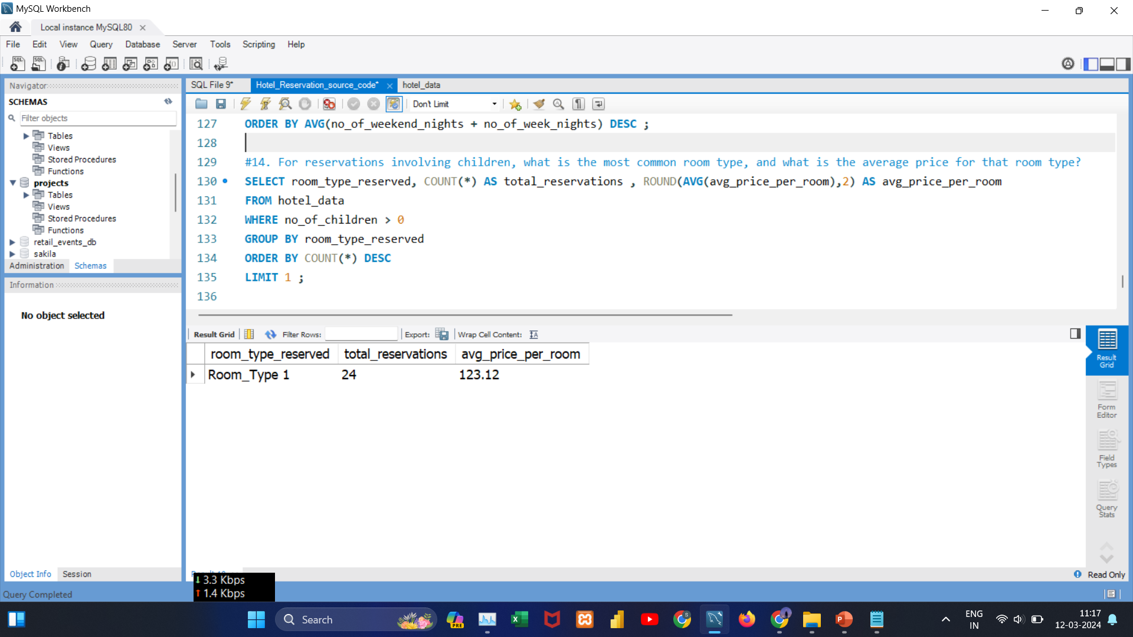
Data Analysis Tasks
14. For reservations involving children, what is the most common room type, and what is the average price for that room type?
Overview:
Room_Type 1 is the popular choice for reservations involving children, with an average room price of 123.12.

Slide 18
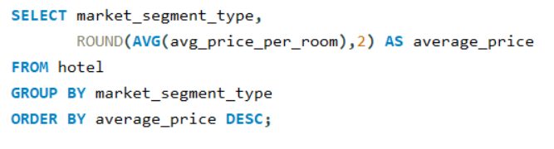
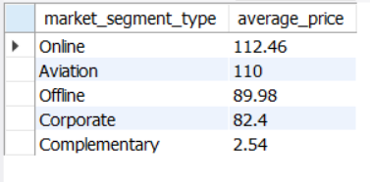
Data Analysis Tasks
15. Find the market segment type that generates the highest average price per room.
Overview:
As compared to other segment types, online bookings generate the highest average room price that is of 112.46.

Slide 19
Thank
You!

